Slide 1
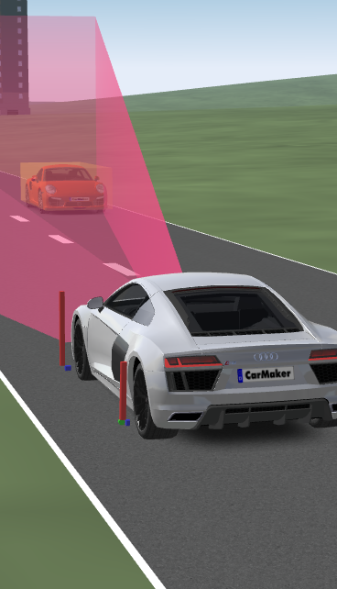
Developing an OEDR Module For Autonomous Vehicle Using Simulators
Authors:
Souvik Mandal and Tatavarthy Venkat Nikhil
B. Tech CSE Final Year
IIT Indore
Gourinath Banda
Associate Professor in CSE
IIT Indore

Slide 2
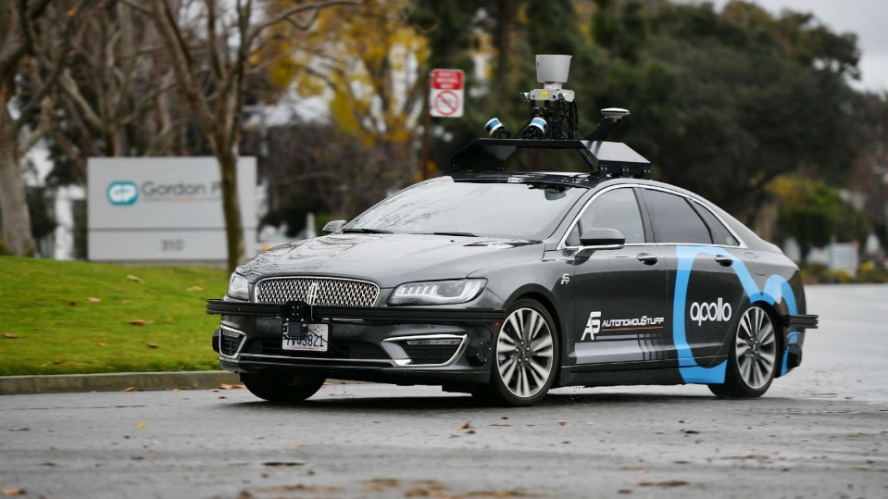
Problem Definition
To develop an Object and Event Detection and Recognition module with:
Camera Sensor
LIDAR Sensor
using the IPG CarMaker Simulator
Collect video stream from camera sensors from IPG CarMaker Simulator

Slide 3
Motivation
Getting started in the absence of real time test environment
OEDR module is important as a perception unit for autonomous cars
IPG CarMaker simulator lets to define complex scenarios
Simulators make it possible for virtual training and testing
DOING MORE

Slide 4
Advantages with IPG-CarMaker
Wide variety of environment/scenarios can be configured
Allows for instantiating different sensor models
Minimum dependency on hardware
DOING MORE

Slide 5
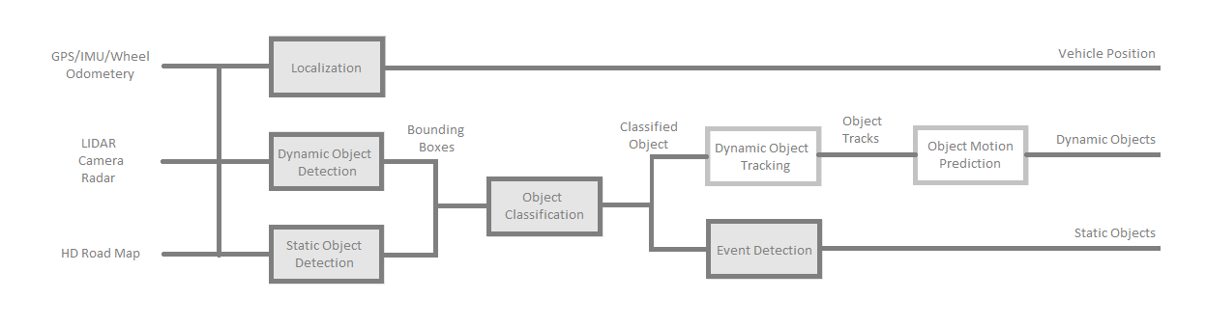
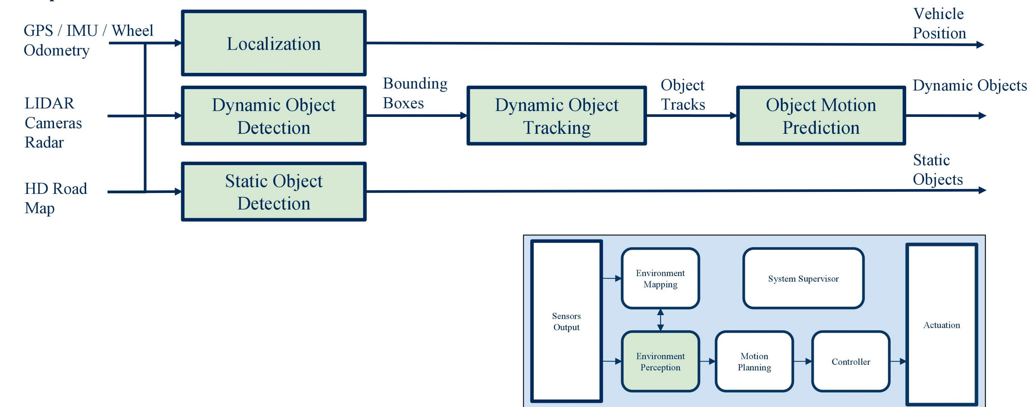
Autonomous Driving

Slide 6
Project details
We generated dynamic traffic with various traffic entities
We have successfully collected camera sensor data from ego vehicle
in real time
We have processed collected data from the stereoscopic cameras
in real-time
We have implemented and integrated modules like
Static object identification and classification for traffic sign traffic light, lane, etc.
Dynamic object identification and classification for car, motorcycle, etc.
Event detection for traffic light and traffic sign state identification
Localization for ego vehicle’s relative position
DOING MORE

Slide 7
Environment Setup
Virtual Environment
We have create several virtual scenarios in IPG CarMaker.
We have configured the camera sensor for live processing of video stream.
Sensor data collection from camera sensors

Slide 8
Traffic Scenarios modelled in IPG-CarMaker
We created more than 20 virtual test environment with the
combination of Car, Bus, Bicycle, Motorcycle, Pedestrian, Truck
For example, in one virtual test environment we had following
configuration
Cars: 8, Bicycle: 12, Bike: 8, Pedestrian: 9
DOING MORE

Slide 9
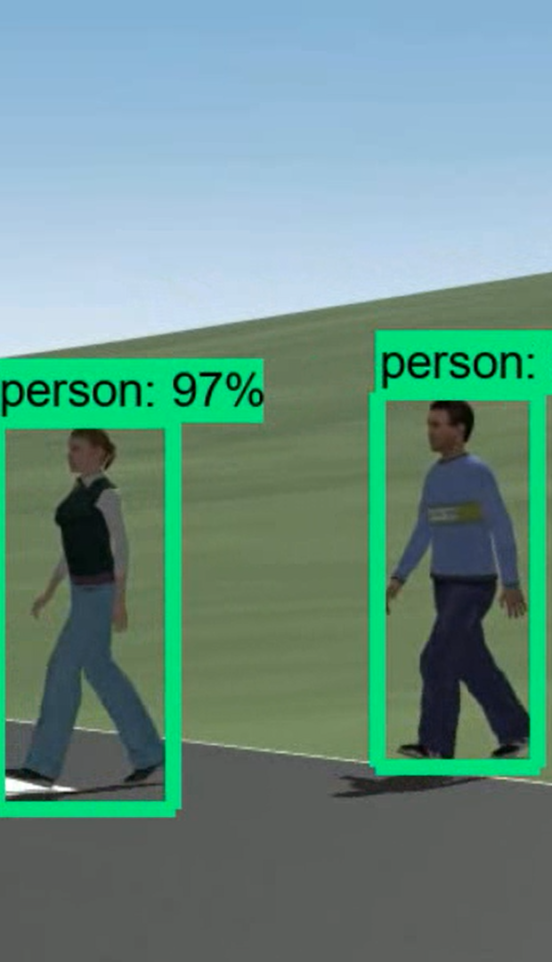
Object Detection Algorithms
Several real time object detection algorithms considered:
Mask R-CNN
It is a new state of the art in field of instance segmentation. It extends faster R-CNN by adding a branch for predicting an object mask.
Single Shot Detector
It takes one single shot to detect multiple objects within the image. It’s much faster than Mask R-CNN but Mask R-CNN has much higher precision.

Slide 10

Object Detection Algorithms
Several real time object detection algorithms considered:
YOLO
YOLO is extremely fast and reasonably accurate.
Its accuracy is similar to Mask R-CNN and also has better detection time than single shot detector.
As we wanted our OEDR module to be fast with out loosing accuracy we chose YOLO.

Slide 11
Traffic Datasets
We wanted to train our machine learning models with reasonable size of dataset but due to high GPU requirements we trained them with small sized dataset.
We trained our models with real life traffic dataset because we did not have access to IPG CarMaker traffic dataset.

Slide 12

Traffic Datasets
Urban Traffic Datasets Considered
Lyft:
Large dataset size (>100 GB Training Data), Incompatible image annotation (3D Annotation)
Waymo:
Large dataset size (~1 TB)
Rovit:
Small dataset size (~23 GB), Compatible image annotation (2D Annotation)

Slide 13
YOLOv3
YOLO stands for You Only Look Once
It is fully Convolutional layer with skip connection and up-sampling
We preferred YOLOv3 over YOLOv2 or YOLO
Because small objects are detected with higher accuracy compared to it’s predecessors for it’s three level detection and classification.
DOING MORE
Notes:
Different grid size should we put after for

Slide 14
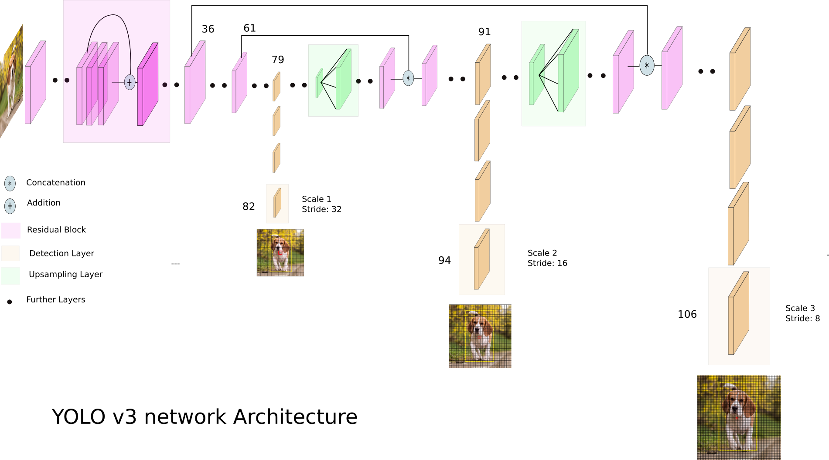
YOLOv3
Image Credit: Ayoosh Kathuria

Slide 15
Traffic Light Classification
We considered machine learning and
computer vision models.
As computer vision models are as accurate
as machine learning models in this use
case with higher performance we selected
computer vision model.

Slide 16
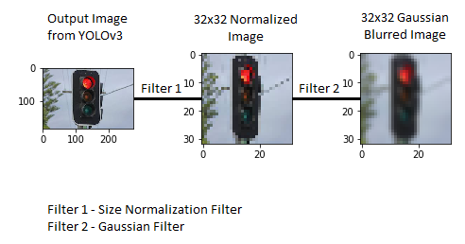
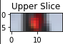
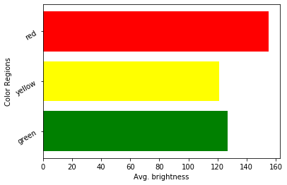
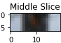
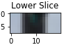
Traffic Light Classification

Slide 17
Traffic Light Classification
Average Time for computation is 0.0033 s
Testing Images for red Traffic light illuminated 723
Testing Images for green traffic light illuminated 429
Testing Images for yellow traffic light illuminated 44
100% accuracy for Red traffic light illuminated.
100% accuracy for Yellow traffic light illuminated.
99% accuracy for Green traffic light illuminated.
DOING MORE

Slide 18
Traffic Sign Classification
We first used LeNet-5 architecture.
We achieved ~91% accuracy.
We have customized LeNet-5 architecture
to improve performance for our use case.

Slide 19
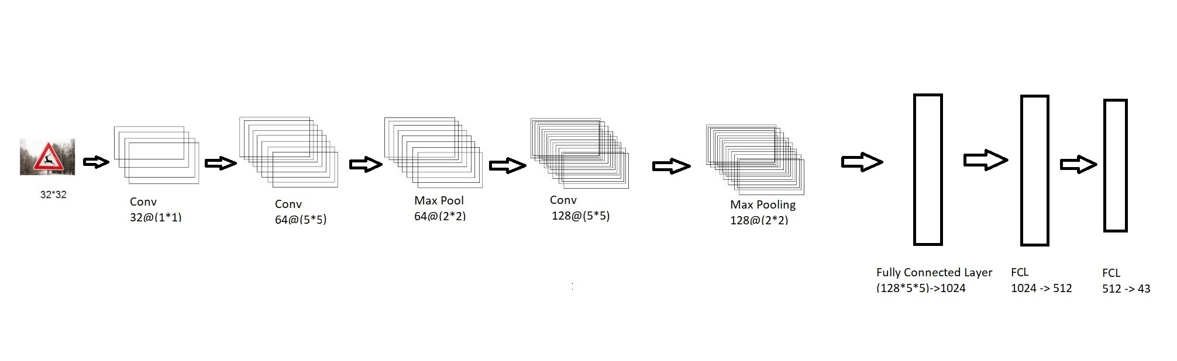
Traffic Sign Classification
DOING MORE

Slide 20
Traffic Sign Classification
Total Number of Classes: 43 [German Traffic Sign Dataset]
Training Images 34799
Testing Images 10000
Accuracy of the Model is 97%
Average Time for computation is 0.0033 s

Slide 21
Lane Detection
Lane detection module consists outputs detected lane co-ordinates as well as radius of curvature of the road.
We have used computer vision techniques in this module.

Slide 22
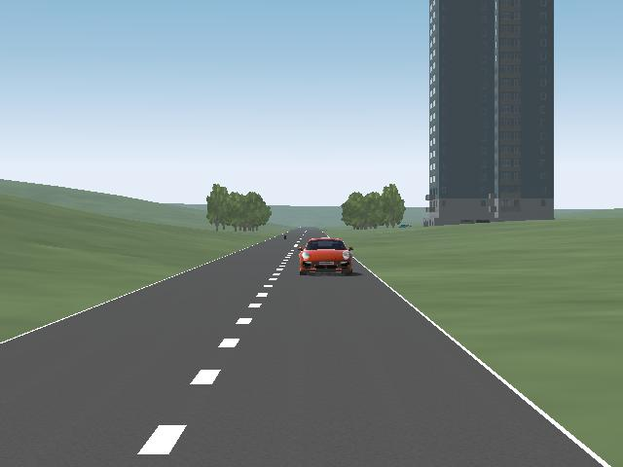
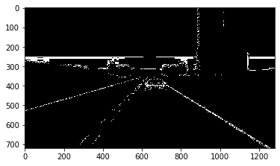
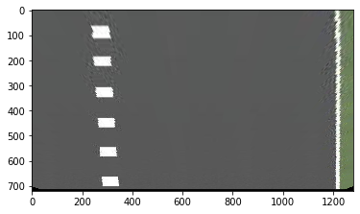
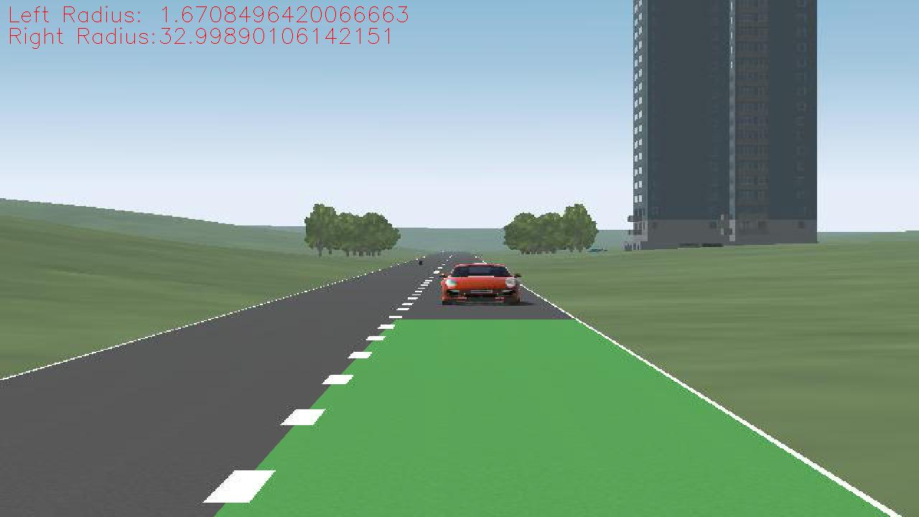
Lane Detection

Slide 23
Traffic Depth Estimation
We have used stereo depth estimation
techniques to measure depth.
For this purpose we have used two camera
sensors in our ego vehicle (in IPG-CM).

Slide 24
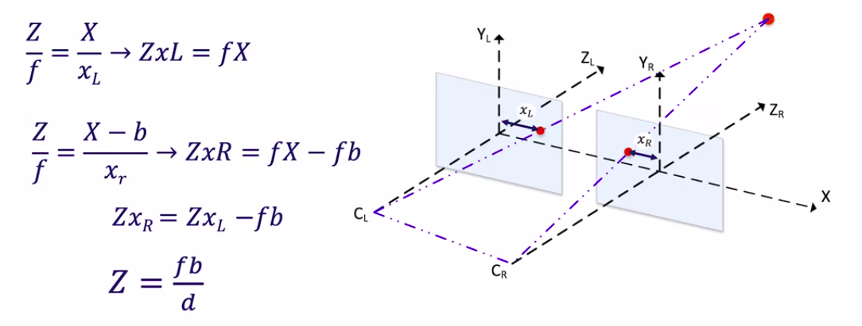
Depth Estimation
Image Credit: Coursera

Slide 25
Depth Estimation
Semi Global Block Matching
Accuracy of depth estimation is directly proportional to the area
of the image overlap.
We can improve the accuracy by increasing the field of view of
camera sensors.
Block size: 11
Max disparity value: 400
Minimum distance for estimation from the camera: 3m

Slide 26
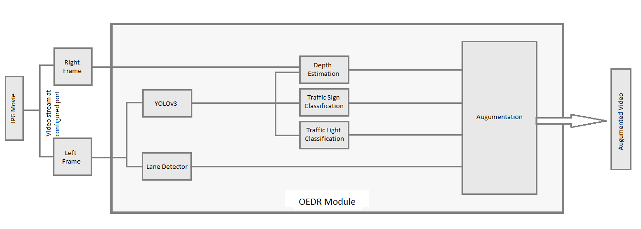
Camera Integration

Slide 27
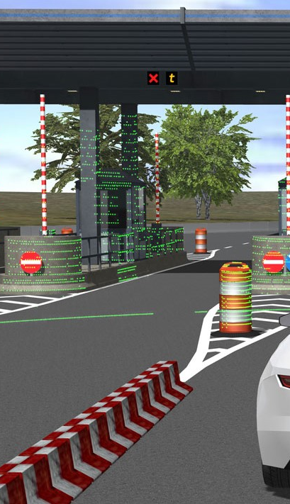
LIDAR
LIDAR stands for Light Detection and Ranging
It is used for improved detection
We have used Euclidean clustering algorithm
DOING MORE

Slide 28
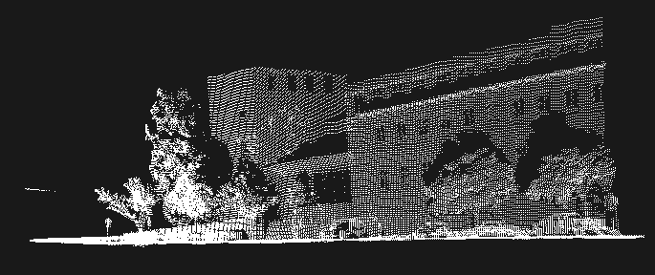
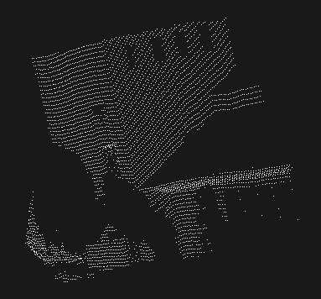
LIDAR
DOING MORE

Slide 29
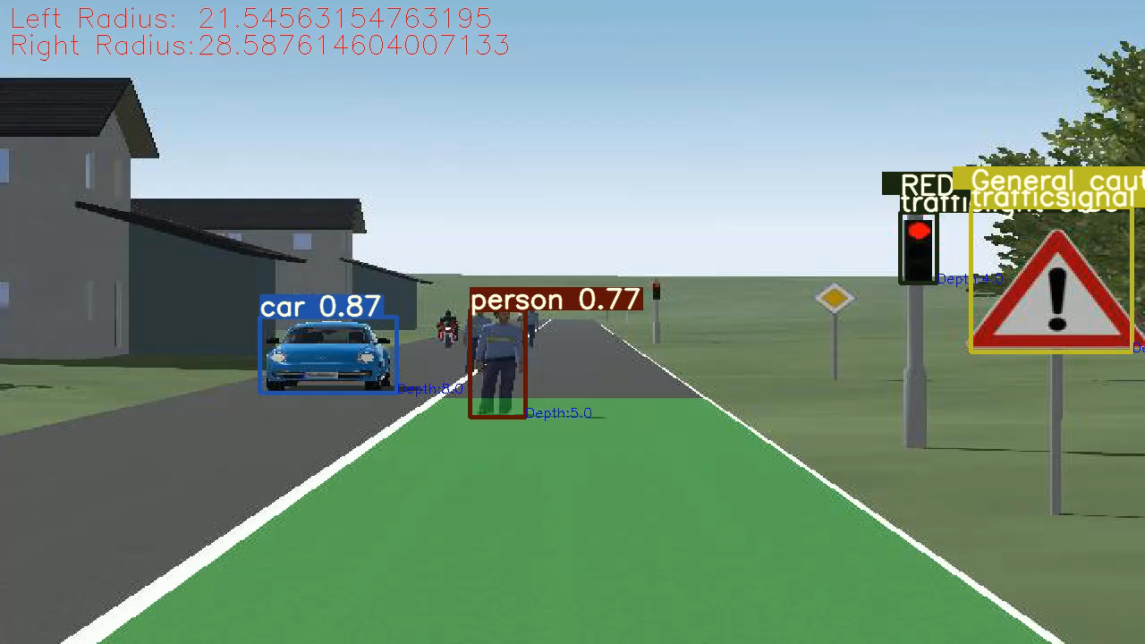

Slide 30
Future Scope
Automated Test Scenario Generation
Motion Prediction
Safety Of The Intended Functionality (SOTIF)
More sensors and Sensor fusion

Slide 31
THANK
YOU

